Slide 1

Optimal and Heuristic Methods for the School Bus Fleet Size Problem
Herbert F. Lewis, PhD
Thomas R. Sexton, PhD
Sreekanth Mallikarjun, PhD
Jiayuan Zhang

Slide 2
Literature Review
Author | Paper | Method | Year
Xiaopan Chen, Yunfeng Kong, Lanxue Dang, Yane Hou, Xinyue Ye | Exact and Metaheuristic Approaches for a Bi-Objective School Bus Scheduling Problem | Search based algorithm | 2015
Byung-In Ki, Seongbae Kim, Junhyuk Park | A School Bus Scheduling Problem | Branch-and-bound methods and construction algorithm | 2011
Armin Fugenschuh | Solving a School Bus Scheduling Problem with Integer Programming | Mixed integer program and relaxation | 2009
Arthur J. Swersey , Wilson Ballard | Scheduling School Buses | Mixed Integer program and relaxation | 1984

Slide 3
Abstract
We present optimal and heuristic algorithms to minimize the number of school buses required to transport students subject to constraints on school bell times and delivery time windows, while considering travel time. By minimizing the number of buses required, we can save money to invest on education.
Notes:
We are using this problem for morning problem schedule, we can do the afternoon problem if we modify it. For the whole day, we need to maximum the routes of morning and afternoon.

Slide 4
Definitions
Run: The sequence of bus stops from the beginning point to the school.
Route: One or more runs linked together and served by a single bus.
Start time: The time a bus starts at the beginning of a run.
Run time: Time required to complete a run.
Bell time: The latest time at which the bus can arrive at the school.
Time window: The maximum number of minutes before the bell time during which the bus may arrive.
Deadhead time: Time required to travel from a school to the origin point of a run.

Slide 5

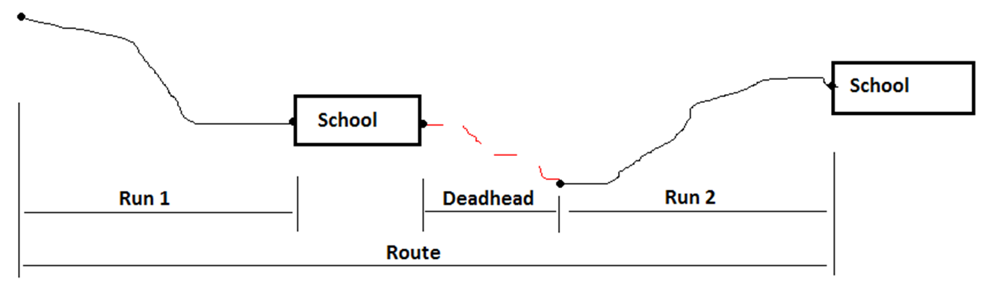
B
A

Slide 6
Problem Statement
All the runs are predetermined and fixed and the time for each run is known. We need to coordinate and link as many runs as possible with respect to time windows and bell time. In short, we maximize the number of links which, in turn, minimizes the number of buses required.
Known: Runs
Unknown: Routes (links)
Objective: Min number of buses

Slide 7
Variables and Parameters
Variables:
S_{i} = Start time for run i
X_{ij} = 1 if run i immediately precedes run j and = 0 otherwise
Parameters:
B_{i} = Bell time at school associated with run i
W_{i} = Length of the time window at school associated with run i
R_{i} = Time to complete run i
T_{ij} = Deadhead time between run i and run j

Slide 8
Methods
1. Optimization method solves the school bus fleet size problem optimally by using a mixed integer linear programming model. Both routing and scheduling problems are solved simultaneously. It becomes computationally intractable when the problem size increases.
2. Greedy heuristic method for the routing portion and an optimal method for the scheduling portion.

Slide 9
1. Optimization Model (Routing and Scheduling)
If number of runs = n
Number of variables = n²
Number of constraints = 3n + n²

Slide 10
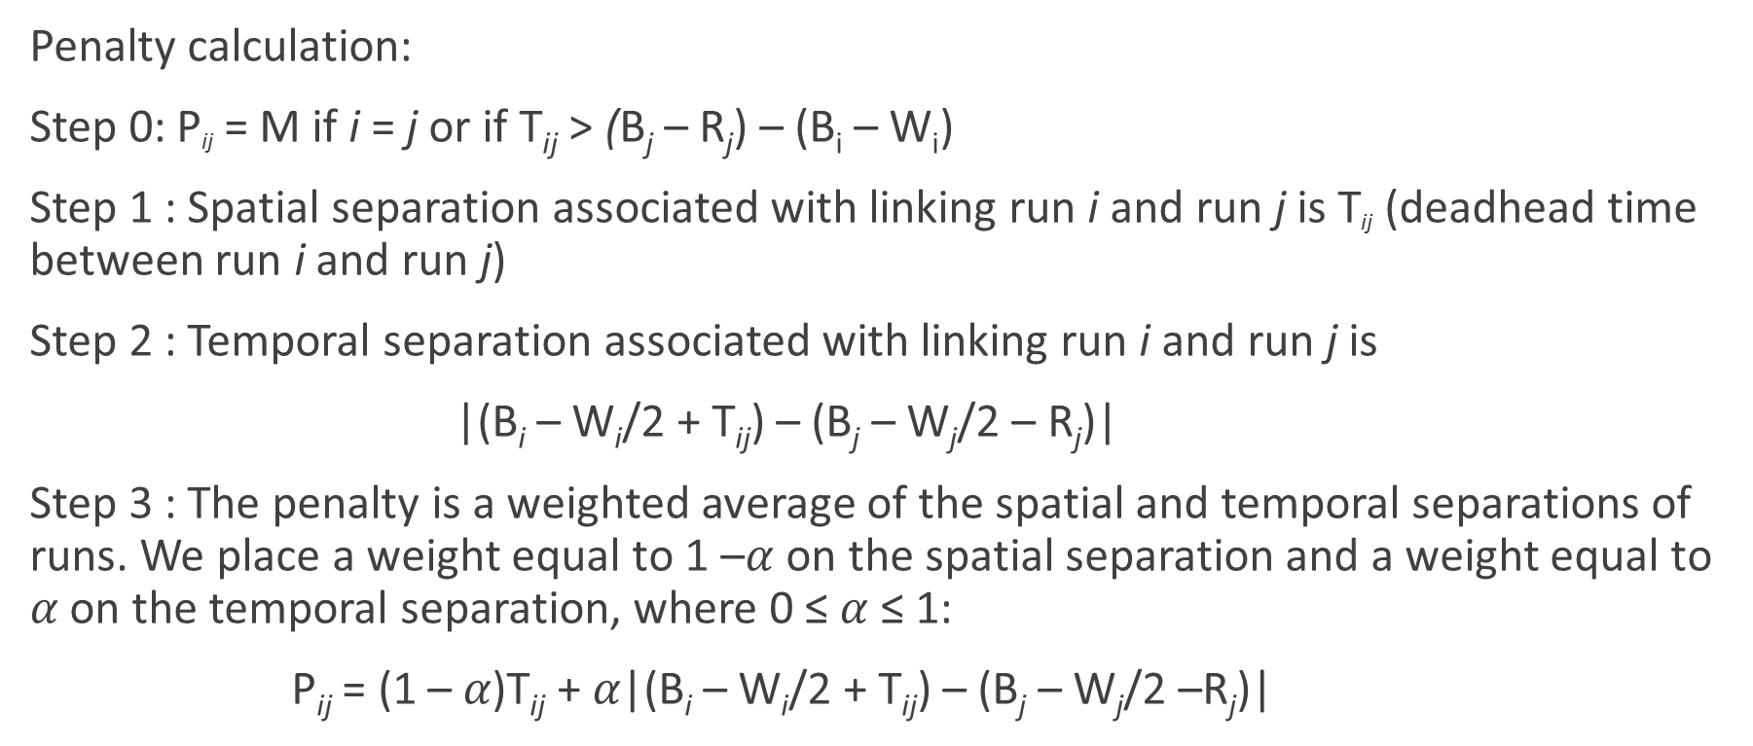
2 Greedy Heuristic (Routing Only)
Penalty calculation:
Step 0: P_{ij} = M if i = j or if T_{ij} > (B_{j} – R_{j}) – (B_{i} – W_{i})
Step 1 : Spatial separation associated with linking run i and run j is T_{ij} (deadhead time between run i and run j)
Step 2 : Temporal separation associated with linking run i and run j is
|(B_{i} – W_{i}/2 + T_{ij}) – (B_{j} – W_{j}/2 – R_{j})|
Step 3 : The penalty is a weighted average of the spatial and temporal separations of runs. We place a weight equal to 1 –$α$ on the spatial separation and a weight equal to 𝛼 on the temporal separation, where 0 ≤ 𝛼 ≤ 1:
P_{ij} = (1 – 𝛼)T_{ij} + 𝛼|(B_{i} – W_{i}/2 + T_{ij}) – (B_{j} – W_{j}/2 –R_{j})|

Slide 11
Greedy Algorithm
Find smallest penalty in the penalty matrix (number of runs x number of runs).
Add the link associated with this penalty to the list and delete the row and column associated with this smallest penalty.
Repeat Steps 1 and 2 until all remaining penalties equal M.
Seek a feasible schedule for the links identified.
If no feasible schedule, then drop the link with the highest penalty and repeat Step 4. If we find a feasible schedule, then the number of buses required equals the number of runs minus the number of links. Stop.

Slide 12
Penalty List with n = 20 and α = 0.85
Route | Runs Linked | Penalty Value
1 | 217-241 | 2.62
2 | 31-320 | 4.15627
3 | 50-240 | 5.22
4 | 241-337 | 6.70645
5 | 285-102 | 7.13745
6 | 252-145 | 7.24227
7 | 273-123 | 7.48273
8 | 123-72 | 8.73182
9 | 198-235 | 9.67282
10 | 170-217 | 11.6414
11 | 261-31 | 20.6314
12 | 145-142 | 23.1855
13 | 264-285 | 30.3879

Slide 13
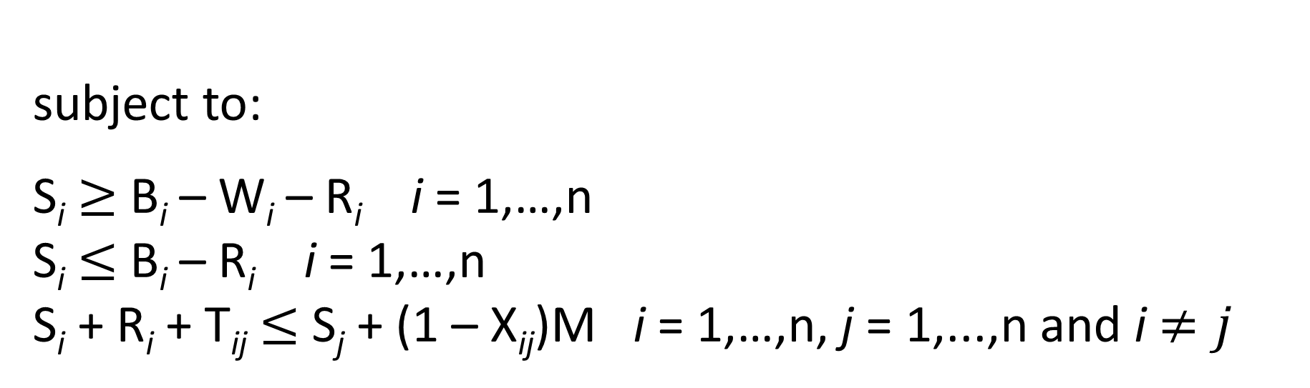

Optimal Method for Scheduling Portion of Greedy Heuristic
$$\sum_{i=1}^{n}{S_{i}}$$
Minimize
subject to:
S_{i} $≥$ B_{i} – W_{i} – R_{i} i = 1,…,n
S_{i} $≤$ B_{i} – R_{i} i = 1,…,n
S_{i} + R_{i} + T_{ij} $≤$ S_{j} + (1 – X_{ij})M i = 1,…,n, j = 1,...,n and i $≠j$

Slide 14
Sample Data Set
We have 17 elementary schools, 3 middle schools and 3 high schools.
The number of runs is 343.
We generate samples of 20, 30, and 40 runs from the 343 total runs.
Each sample includes a proportional allocation of elementary schools, middle schools and high schools.

Slide 15
Sample Data Set
20 Runs: 12 runs come from elementary schools, 4 runs come from high school, and 4 runs come from middle school
30 Runs: 18 runs come from elementary school, 6 runs come from high school, and 6 runs come from middle school
40 Runs: 24 runs come from elementary school, 8 runs come from high school, and 8 runs come from middle school

Slide 16
20 Runs Results
In 20-run samples, the greedy algorithm found the optimal solution in 80% of the samples.

Slide 17
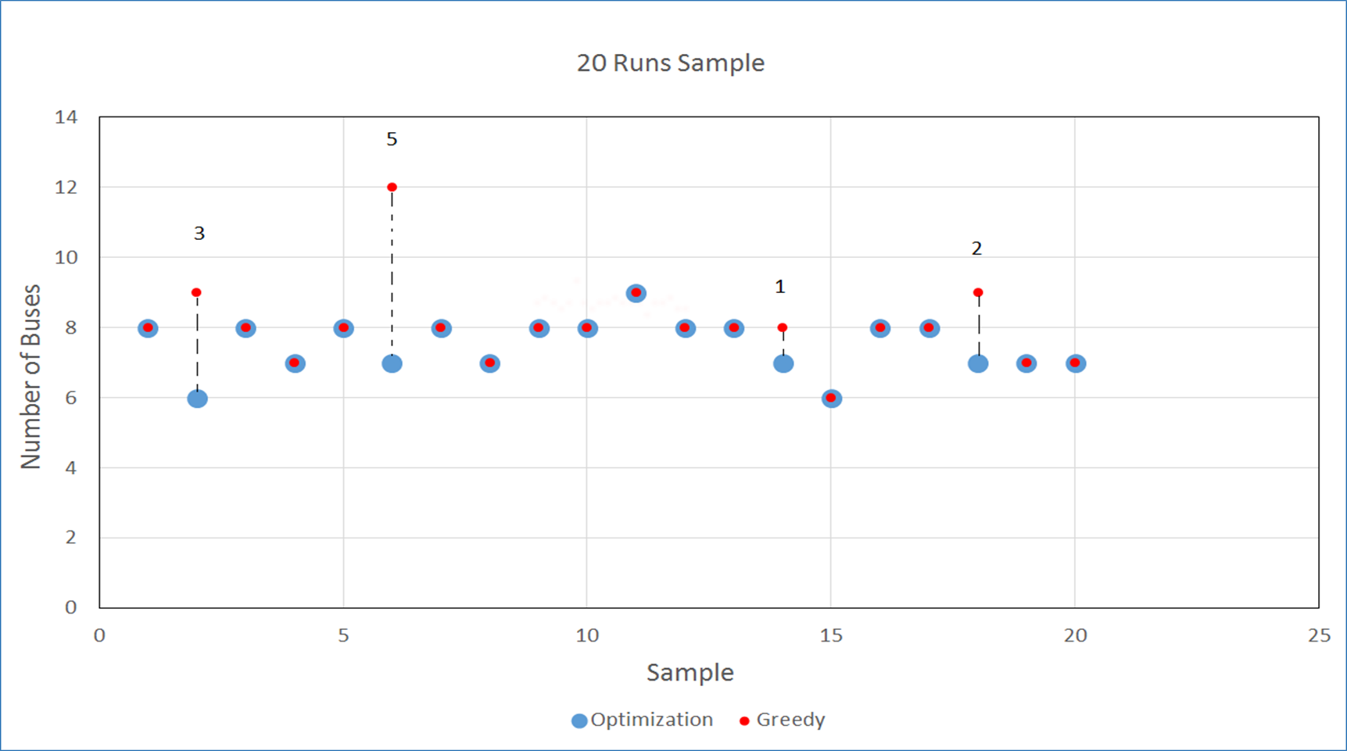

Slide 18
30 Runs Results
In 30-run samples, the greedy algorithm found the optimal solution in 60% of the samples.

Slide 19
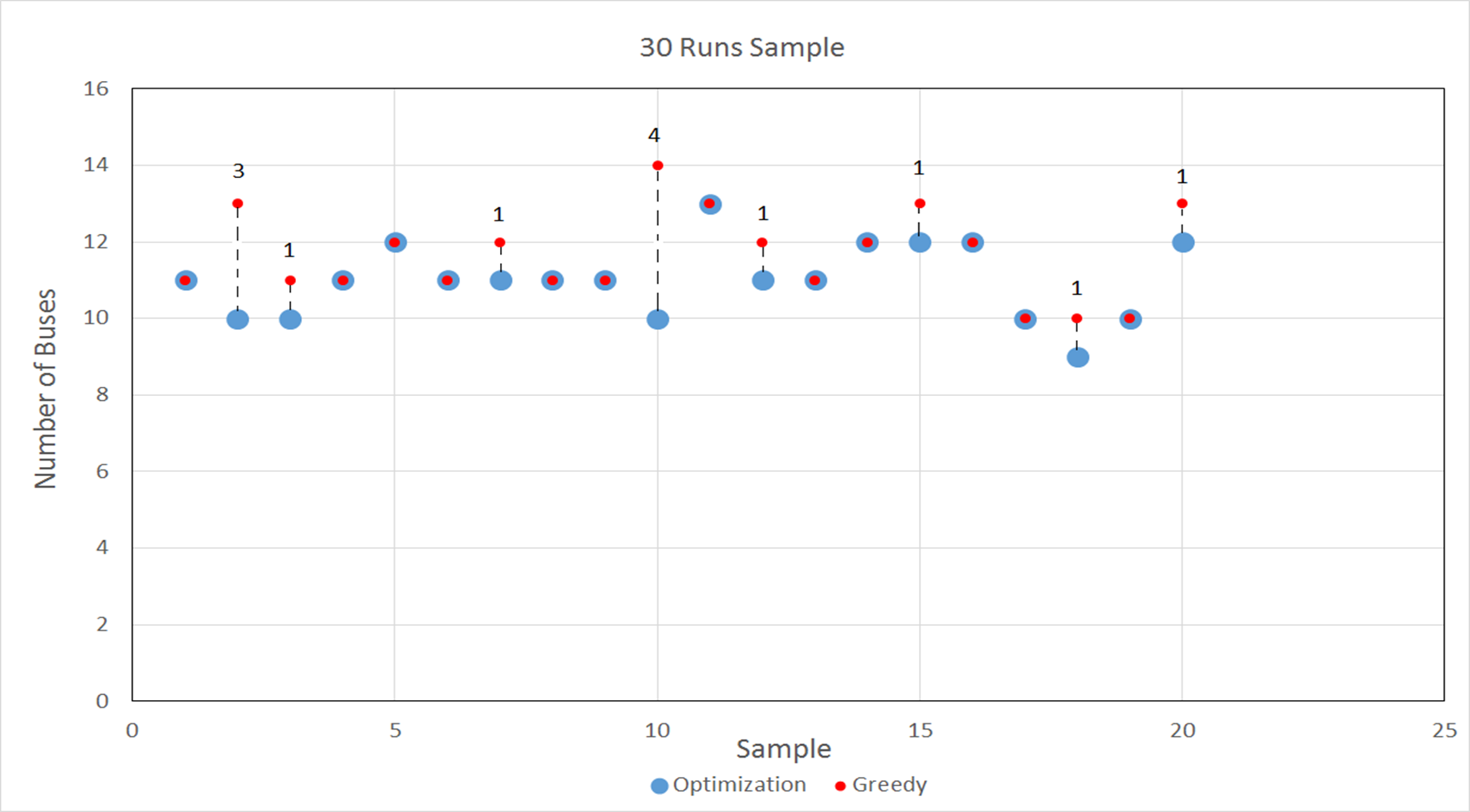

Slide 20
40 Runs Results
In 40-run samples, the greedy algorithm found the optimal solution in 60% of the samples.

Slide 21
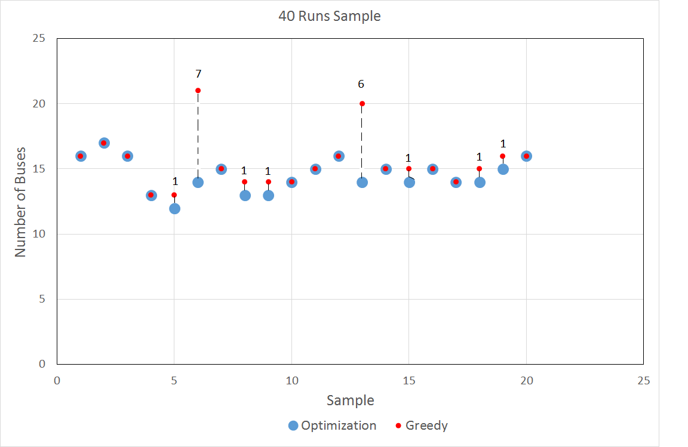

Slide 23
Assignment Heuristic (Routing Only)

Slide 24
Conclusion
The greedy algorithm produced optimal results in more than half of the trial runs.
We still need to test the performance of the greedy algorithm for larger problems.
We also need to test the performance of the assignment algorithm.

Slide 25
Conclusion
We hope that the model can help school districts minimize the number of buses required.
With the money saved, the school district can invest more money on the education of children.

Slide 26
Thank you!

